Slide 1

Mode of action (MOA) prediction for chemical perturbagens using machine learning on static OMICS feature
Aubhishek Zaman, PhD
Lab meeting March,2023

Slide 2
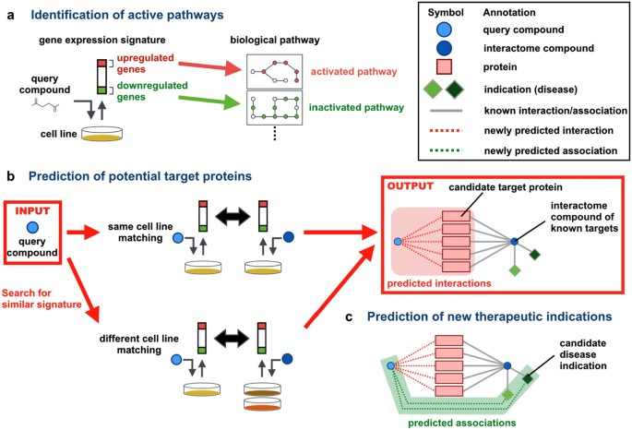
1. Bioactive compound screenings:
Easy to perform
Combinatorial compound libraries are easy to scale
Significance and challenges
2. Current modus operandum:
Gene set enrichment analysis
Weights are much less comprehensive
Less quantitative more qualitative
A group of gene prediction
3. Multiple elastic net regression (MLR):
Quantitative
Deep learning methodology
Train and test needs to be optimized often
Individual biomarker nomination
Iwata et al. 2017

Slide 3
1. Compound response information is relatively sparse
Compared to OMICS features
N/P ratio problem
Results in overfitting: the solution is unique for the dataset and fails on unknown test data
Regularized regression: why do we care
Zaman et al. 2022

Slide 4
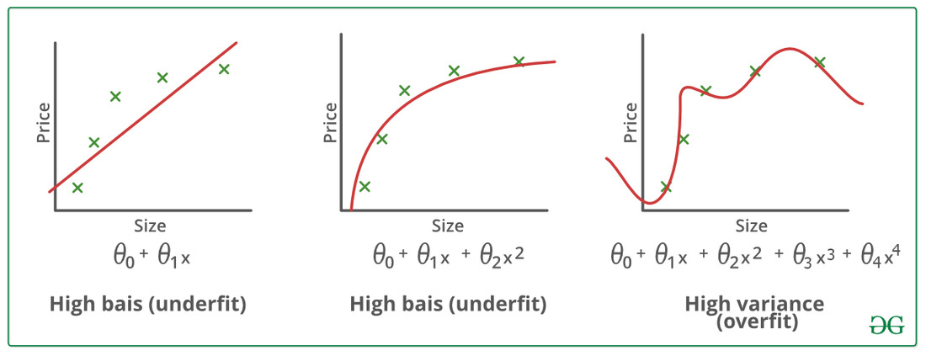
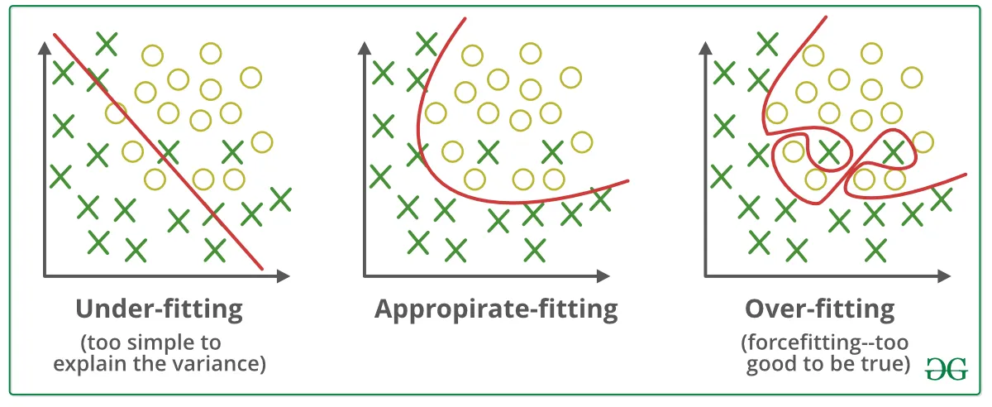
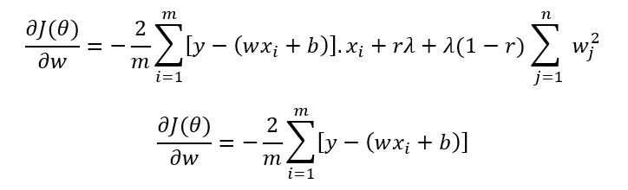
1. Compound response information is relatively sparse
Compared to OMICS features
N/P ratio problem
Results in overfitting: the solution is unique for the dataset and fails on unknown test data
Regularized regression: why do we care

Slide 5
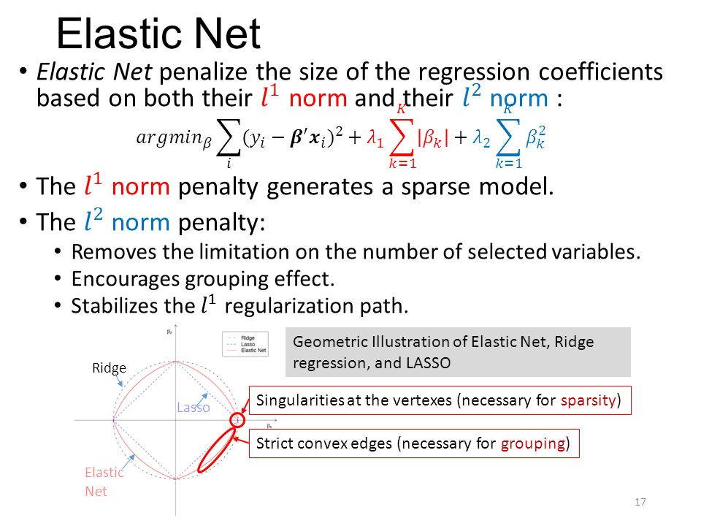
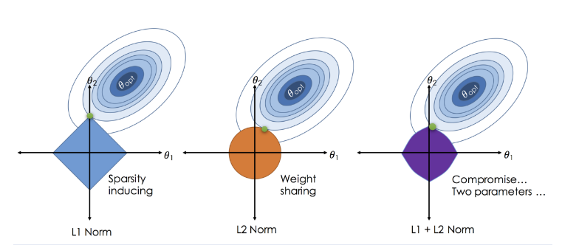
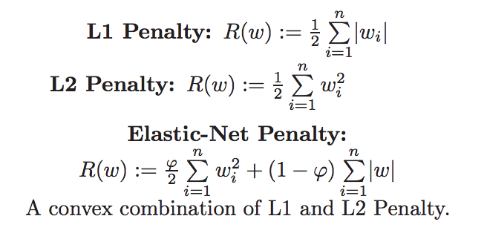
Regularized regression: why do we care
L1 (Lasso) regularization: penalty term that lowers the complexity by minimizing the number of non-zero coefficients (note the w term being zero nullifies wx)
L2 (Ridge) regularization: penalty term that lowers the complexity by making the weights more homogenous (note the squared term for weights, which are fractions)

Slide 6
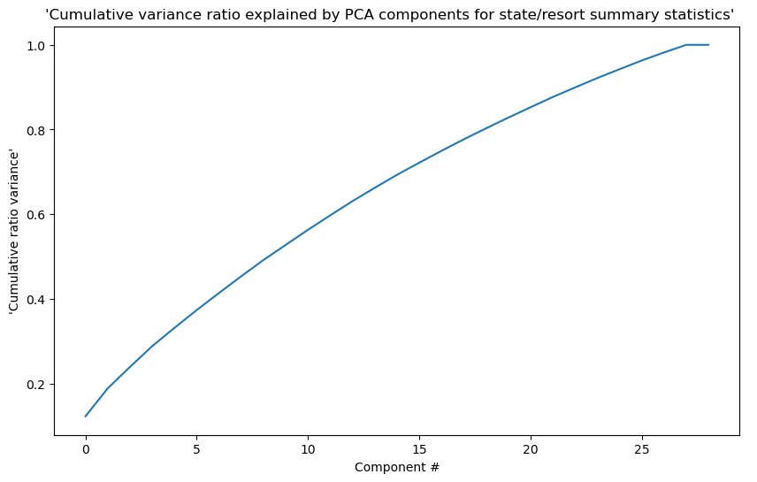
Regularized regression: A theoretical PCA shows complexity cannot be reduced without reducing useful dimensions
Note:
The more the PCA the more the cumsum variance; cumsum variance is not saturating and artificially capped off

Slide 7
Establishing the Elastic net
1. Concept
Dataset1: Each column indicates a cell sample (cell line/tumor tissue) and each row indicates a feature. For example, Transcriptomic Features ~ 55,000 rows, 100 columns.
Dataset2: Response of a drug for each cell sample (cell line/tumor tissue)
For a single drug; we have to create a response (X= target) versus feature (Y= regressors).
Features (~55,000)
LogAC50
Note: Dummy data**

Slide 8
Steps: Data prep
1. Data acquisition
GEO
PDHK1 project
Literature mining: Depmap, POPS
Features (~55,000)
2. Data wrangling and exploratory analysis
PCA
Summary stat
3. Data prep
Null value replacement
Standardization
Scaling and column normalization
LogAC50
Note: Dummy data**

Slide 9
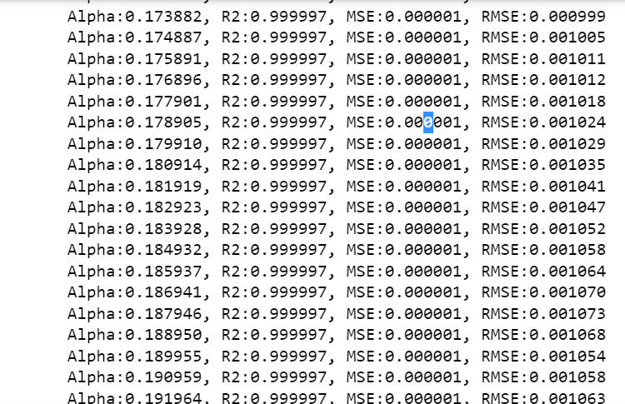
Steps: Modeling
1. Test-train split
Divide the data into test and train
Train and check testing accuracy (prediction vs regular test)
Changing the value of alpha and measuring the change in MSE and RMSE as an indicator of accuracy
2. Elastic net hyperparameter tuning:
alpha
Gridsearch: max iteration
L1_ratio, alpha seleced from gridsearch

Slide 10
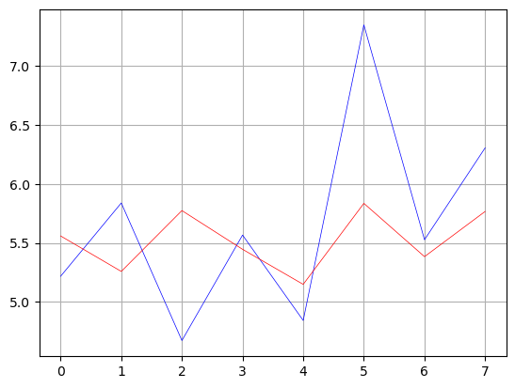
Steps: Modeling
3. K-fold cross-validation:
Randomize (with seed)
Repeat train test split and subsequent analysis
y_pred (prediction) or y_test
4. RMSE and MAE:
Accuracy check: ~0.7
X_test

Slide 11
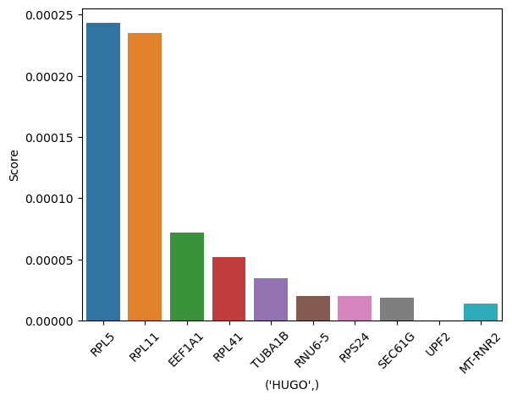
Result for feture importance for chemotherapeutic agent PAK4i

Slide 12
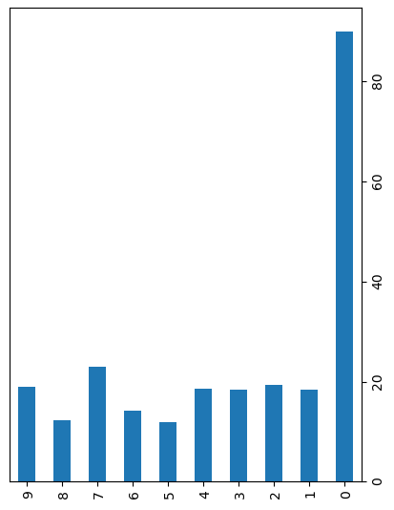
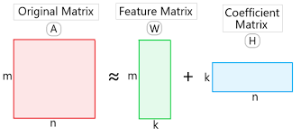
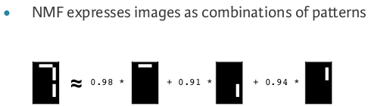
Alternative modeling: NMF (non-negative matrix factorization)
Advantages: multiple OMICS data can be integrated

Slide 13
Things in progress
BRAF and MEK inhibitors (as positive)
PDHK1 compound data
Perturbseq knockdown data
~500 curated compounds from Depmap

